Slide 1
Priyadarshini College of Engineering
Introduction to Linux
Unit 1
By Prof. Sneha A Kamble

Slide 2
Operating System and Its Features
Definition: An operating system (OS) is system software that manages hardware and software resources and provides common services for computer programs.
Features:
Resource Management: Manages CPU, memory, and I/O devices.
User Interface: Provides CLI and GUI for user interaction.
Multitasking: Allows multiple processes to run simultaneously.
Security: Protects data and restricts unauthorized access.
File Management: Organizes, stores, and retrieves data on storage devices.

Slide 3
Definition & Naming of Linux
Definition: Linux is an open-source, Unix-like operating system kernel created by Linus Torvalds in 1991.
Naming: The name "Linux" is derived from the creator’s name, Linus, and Unix, the OS it was inspired by.

Slide 4
History
1991: Linus Torvalds released the first Linux kernel.
1992: Linux adopted the GNU General Public License (GPL).
1993: First Linux distributions like Slackware and Debian were introduced.
2000s: Gained popularity for servers, embedded systems, and desktops.
Present: Powers a vast range of devices from smartphones to supercomputers.

Slide 5
Components of Linux
Kernel: Core of the OS managing system resources.
System Libraries: A collection of pre written code that allows applications to interact with the OS kernel.
System Utilities: A collection of programs and tools that are essential for managing and interacting with the linux OS(e.g., file management).
Shell: Command interpreter for user interaction.
Desktop Environment: GUI for easier use.

Slide 6
Basic Features
Multi User: Supports multiple users simultaneously.
Multitasking: Executes several tasks concurrently.
Portability: Can run on various hardware platforms.
Open Source: Source code is freely available.
Secure: Provides robust security features.

Slide 7
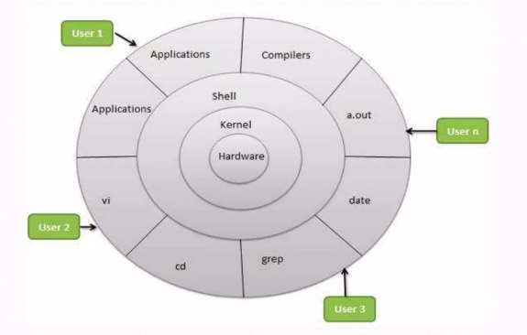
Architecture
User Space: Applications and utilities interact with the kernel.
Kernel Space: Manages system hardware and resources.
Layers:
Hardware: Physical devices.
Kernel: Core system functionality.
System Libraries: APIs for applications.
Applications: User programs.

Slide 8
Kernel
The kernel is the core part of an operating system that manages system resources and allows communication between hardware and software.
Types of Kernels:
Monolithic Kernel: All OS services operate in a single space, providing better performance. Examples: Linux, Unix.
Microkernel: Minimal services run in kernel space; others run in user space, ensuring better modularity and stability. Example: Minix.
Hybrid Kernel: Combines features of monolithic and microkernels, balancing performance and modularity. Example: Windows NT.
Exokernel: Provides minimal abstraction, leaving resource management to applications. Example: Aegis

Slide 9
User Interface View of Linux
CLI (Command Line Interface): Text-based interface for executing commands.
GUI (Graphical User Interface): Visual interface for user interaction.
Example GUIs: GNOME, KDE, Xfce

Slide 10
Distributions of Linux
Popular distributions:
Ubuntu
Fedora
Debian
CentOS
Arch Linux
Specialized distributions:
Kali Linux (security testing)
Raspbian (Raspberry Pi)

Slide 11
Hardware Requirements
Minimal requirements for lightweight distributions:
CPU: 1 GHz processor
RAM: 512 MB
Storage: 5 GB
Modern distributions:
CPU: 2 GHz dual-core processor
RAM: 4 GB or more
Storage: 20 GB or more

Slide 12
Software Applications in Linux
Office Suites: LibreOffice, OpenOffice.
Web Browsers: Firefox, Chromium.
Media Players: VLC, Audacious.
Development Tools: GCC, Python, Node.js.
Virtualization: VirtualBox, KVM.

Slide 13
Editors
Text Editors:
Nano: Simple and user-friendly.
Vim: Advanced editor for developers.
Emacs: Highly customizable.
IDEs:
Visual Studio Code
Eclipse
IntelliJ IDEA

Slide 14
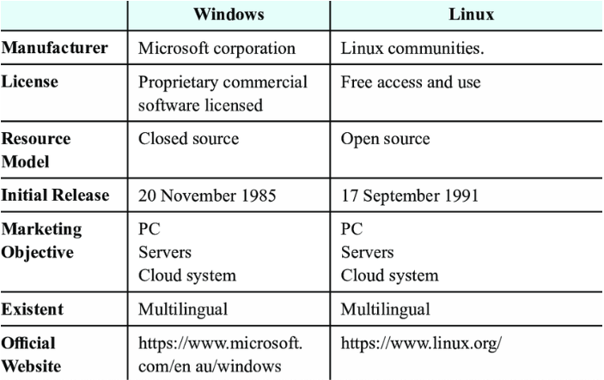
Comparison with Different OS

Slide 15
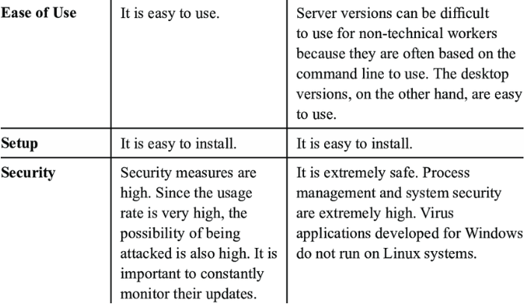
Comparison with Different OS

Slide 16
Important Commands
File Management:
ls, cp, mv, rm
Process Management:
ps, top, kill
System Info:
uname, df, free
Networking:
ping, curl, ifconfig

Slide 17
Merits and Demerits
Merits:
Free and open-source.
Secure and stable.
Customizable.
Lightweight.
Demerits:
Steep learning curve for beginners.
Limited support for proprietary software.

